Slide 1

}
<Name:Chandana Ramoji>
<Project name:Docker project>
<Empid:200111>
*

Slide 2
Introduction to
DOCKER PROJECT
{
< PRESENTED BY:CHANDANA RAMOJI(200111)>
}
...

Slide 3
Contents of this Presentation
From creation to deployment
Spring boot | INTRODUCTION,SPRING BOOT INTIALIZATION,WORKING WITH SPRING BOOT
Maven | Import the file,
Selenium | Introduction , Creation , Running
Docker | Introduction , Creation ,Image creation,
DockerHub | Pushing into docker hub
Git hub | Introduction, Pushing

Slide 4
Table of contents
01
02
03
Introduction
You can describe the topic of the section here
Creation
You can describe the topic of the section here
Working
You can describe the topic of the section here

Slide 5
01
Introduction
{
..
< Spring boot introduction>
}
..

Slide 6

Spring Boot
WHAT IS SPRING BOOT?
Spring is an open-source lightweight framework widely used to develop enterprise applications. Spring Boot is built on top of the conventional spring framework, widely used to develop REST APIs.The most important feature of the Spring Framework is dependency injection
WHY WE USE SPRING BOOT?
Spring framework helps to create a loosely coupled application. Spring Boot helps to create a stand-alone application. In the Spring framework to test the Spring Project, we need to set up the servers explicitly. Spring Boot offers built-in or embedded servers such as Tomcat and jetty.
}
..

Slide 7
How to Intialize springboot?
Do you know hoe to create spring boot project? Here is the steps to follow:
Goto Spring intializer in any web browser
Select the project as maven and language as java and choose the apropriate vesions
Give the artifact group name package and jar version
Then Add Spring Web Dependencies
*
Here are some steps mentioned below

Slide 8
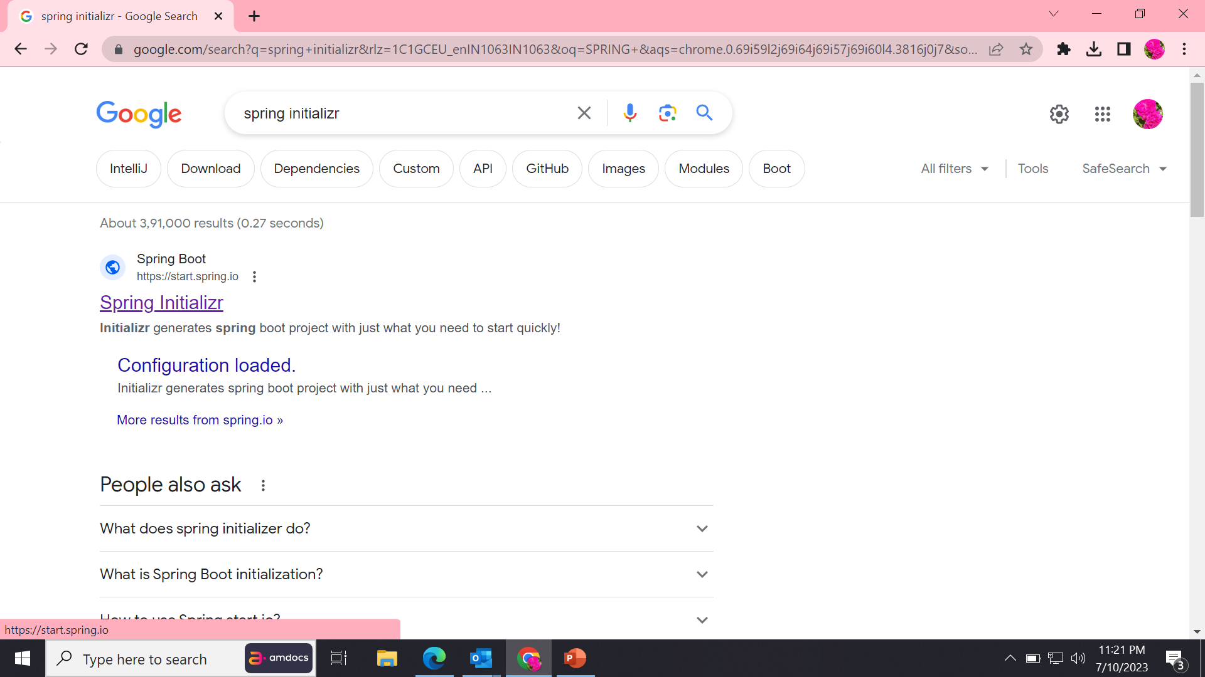
STEP-1:Goto bowser type spring initializer

Slide 9
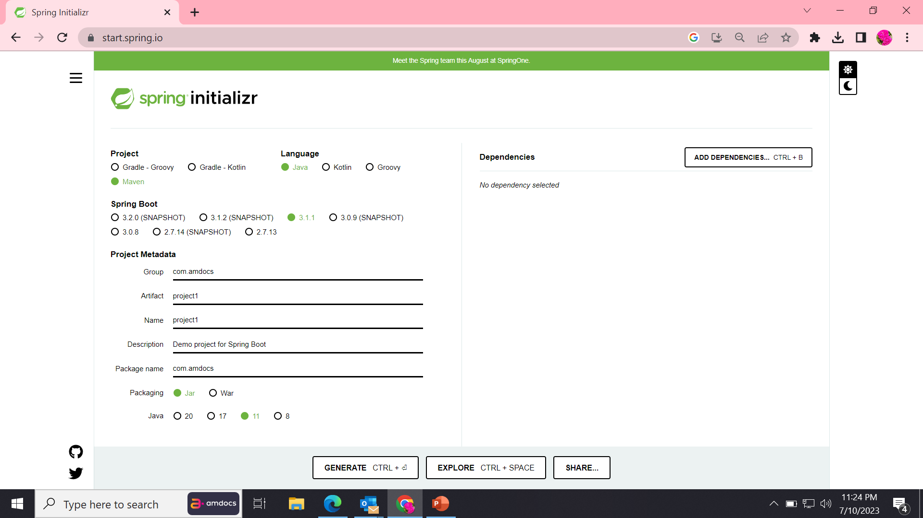
Step-2:PROJECT CREATION

Slide 10
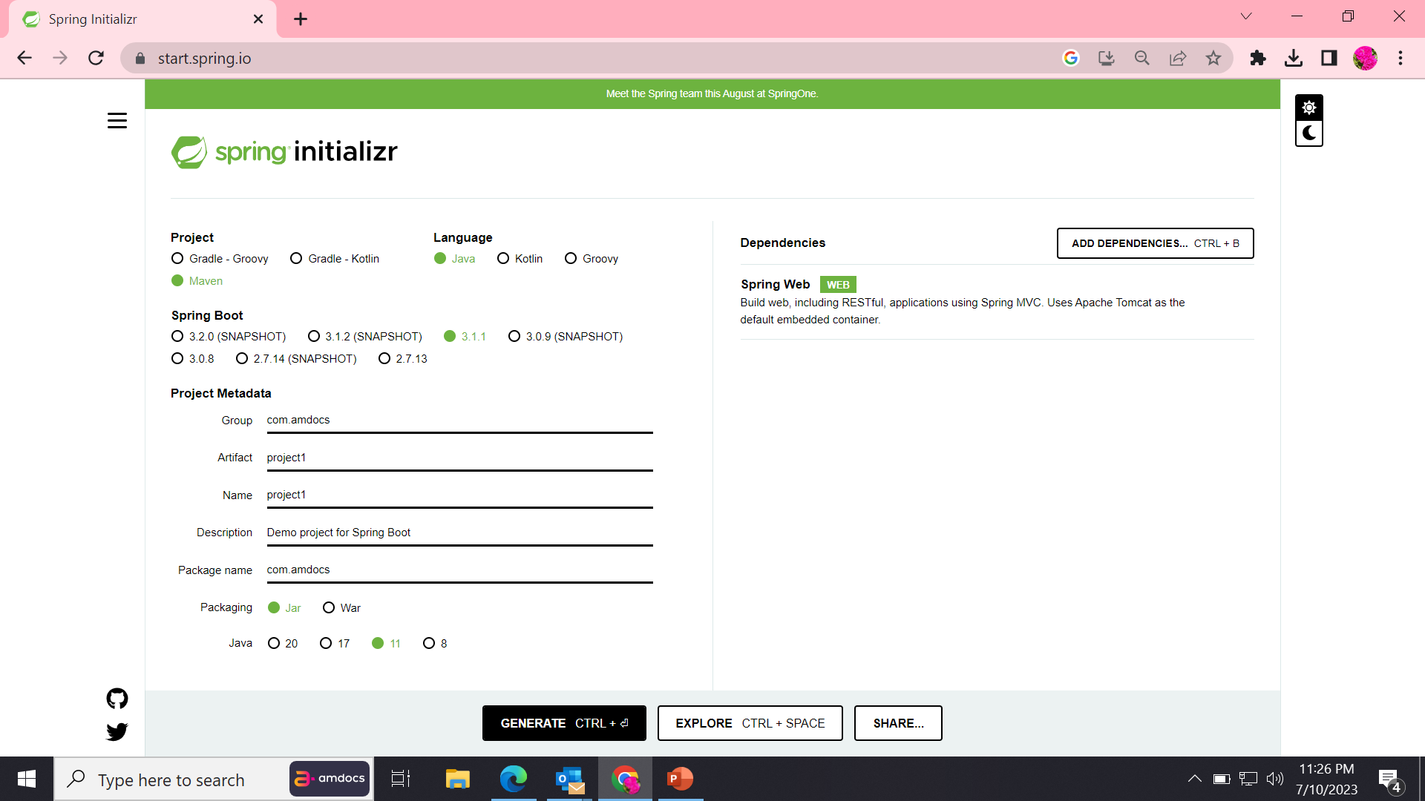
STEP-3:ADD DEPENDENCIES&GENERATION OF FILE

Slide 11
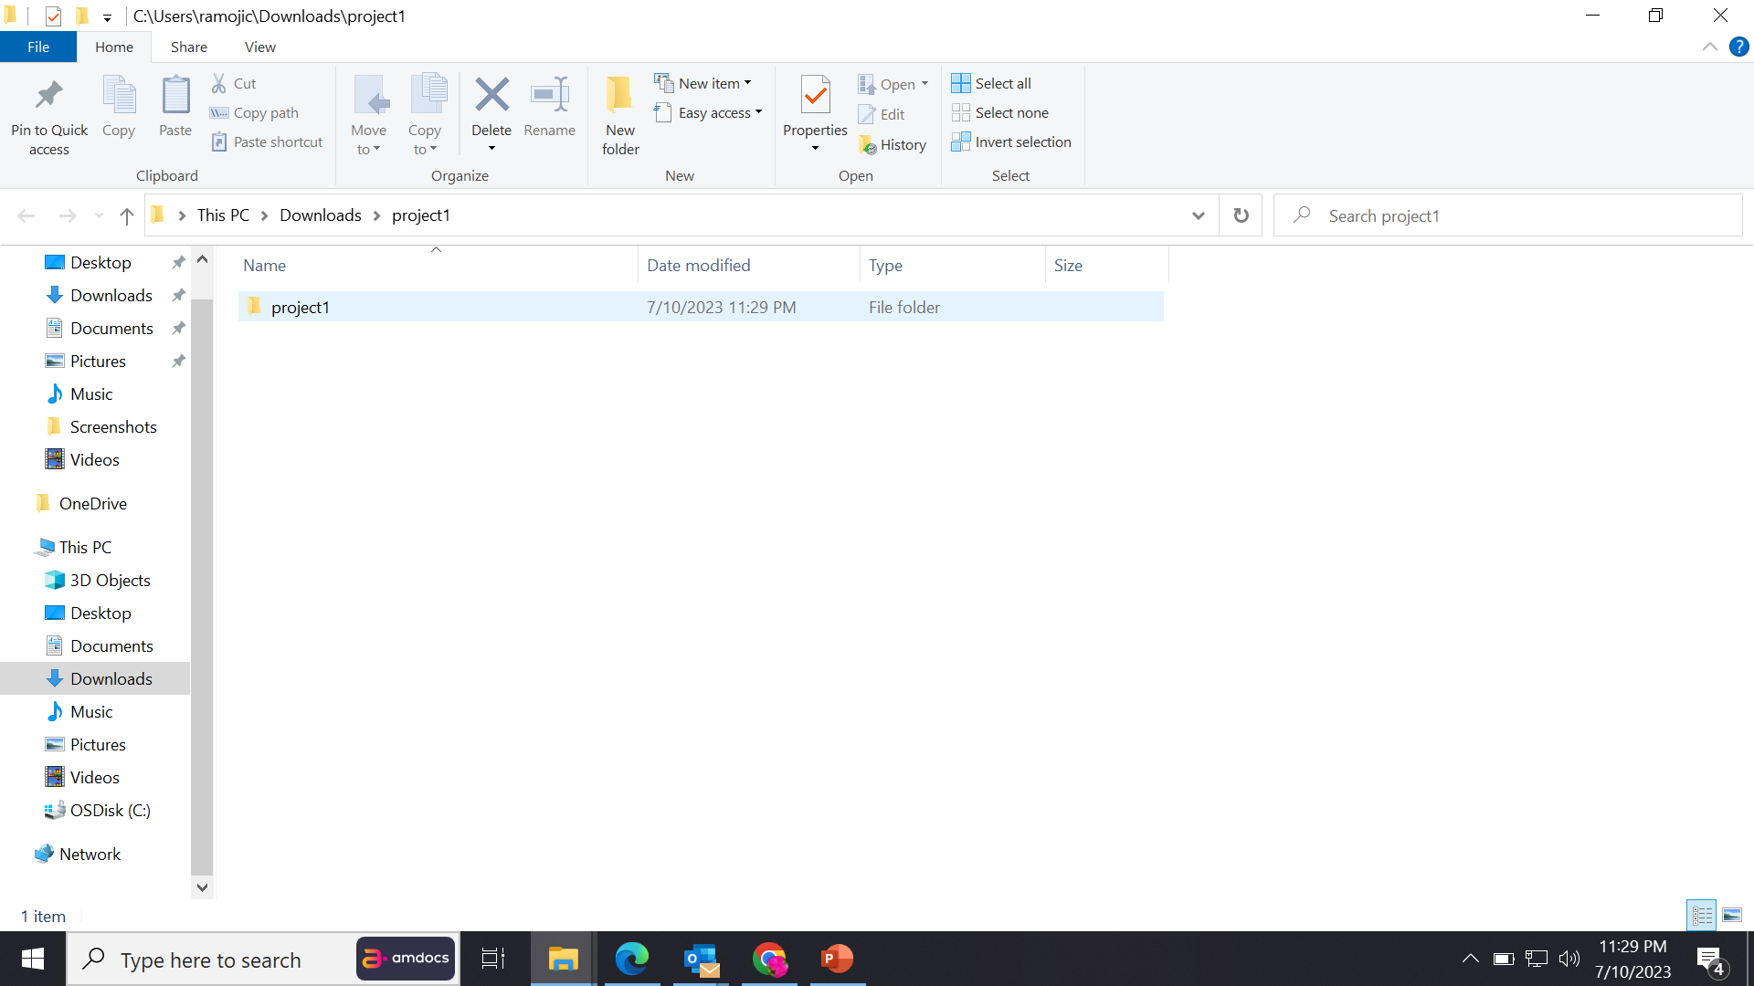
STEP-4:EXACTRACTION FILE

Slide 12
MAVEN
{
WHAT IS MAVEN?
WHY WE USE MAVEN?
Maven is a build automation tool used primarily for Java projects. Maven can also be used to build and manage projects written in C#, Ruby, Scala, and other languages. The Maven project is hosted by The Apache Software Foundation, where it was formerly part of the Jakarta Project.
Maven is chiefly used for Java-based projects, helping to download dependencies, which refers to the libraries or JAR files. The tool helps get the right JAR files for each project as there may be different versions of separate packages.
}
*
EXTRACTING TO MAVEN

Slide 13
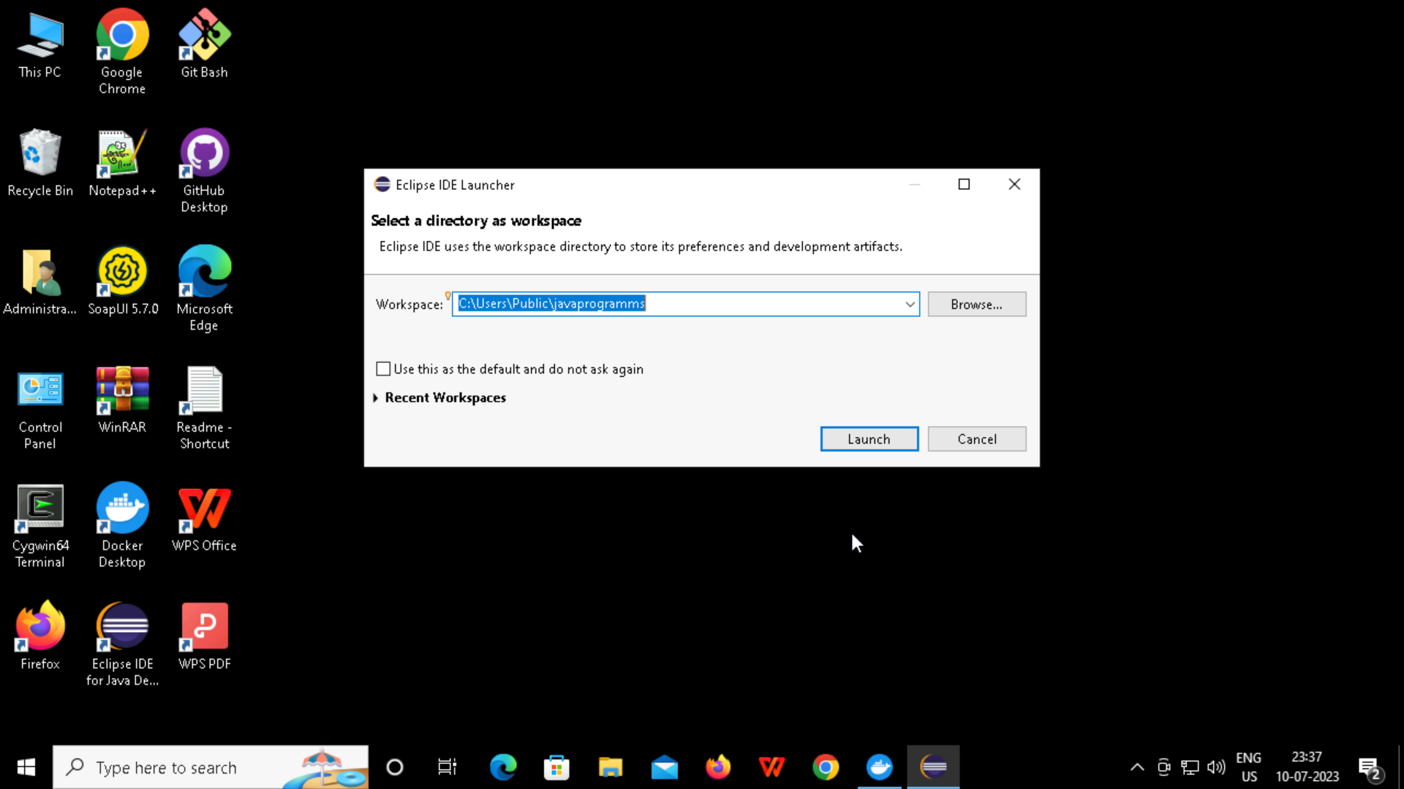
STEP-1:OPEN ECILIPSEP&CONFIGURE PROJECT PATH
1.

Slide 14
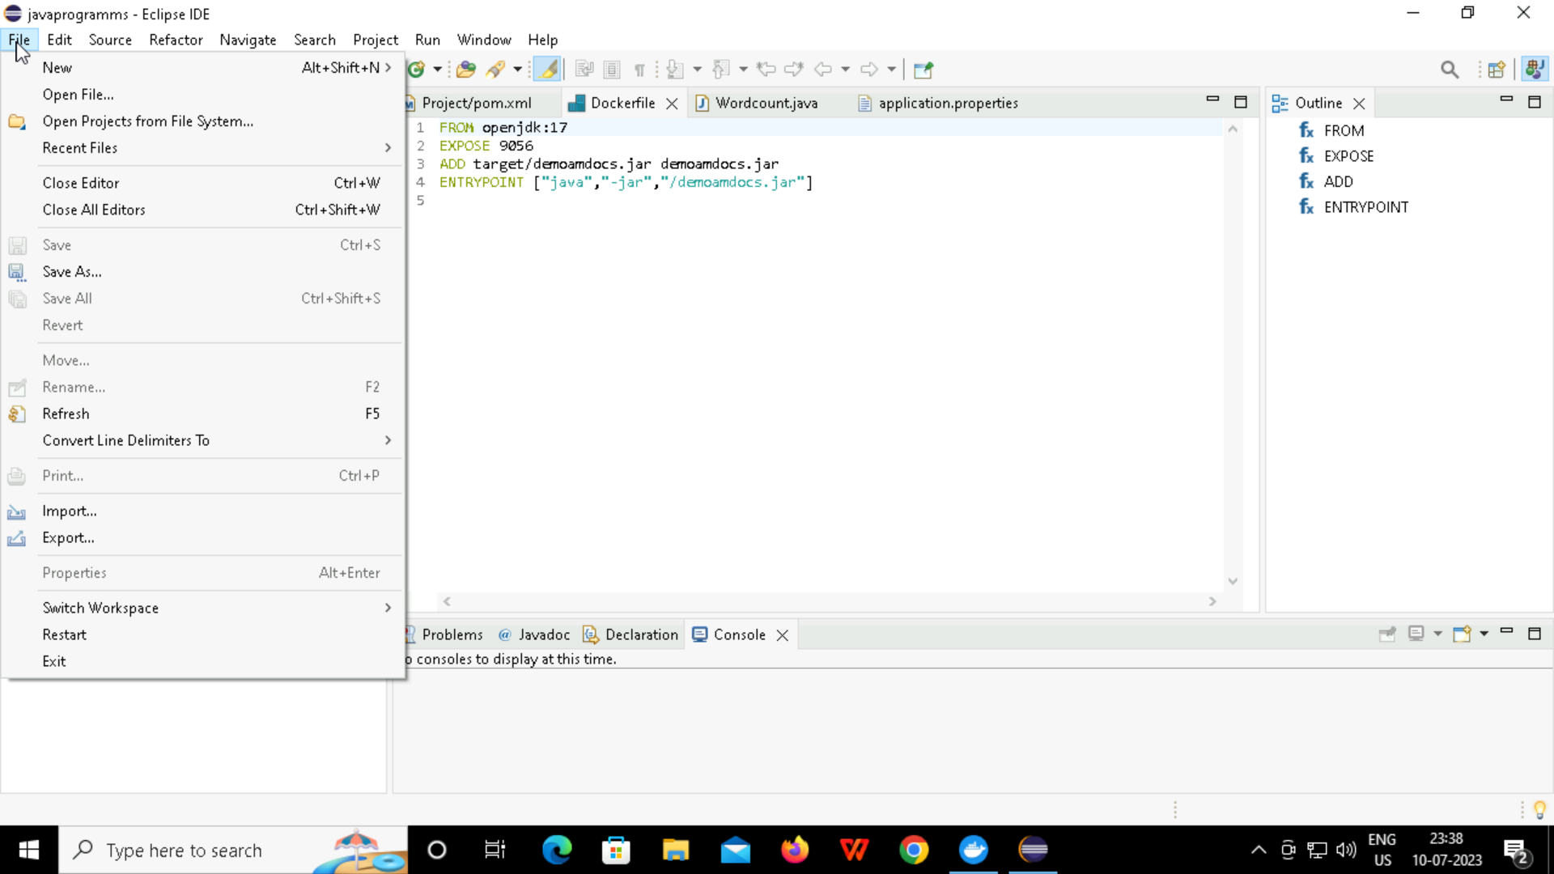
OPEN ECILIPSEP&OPEN FILE PROJECT
2.

Slide 15
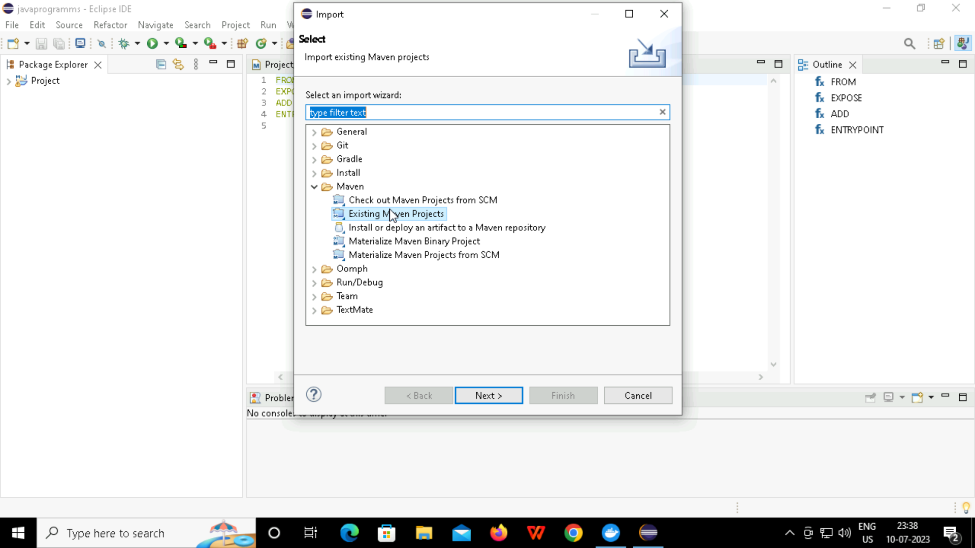
OPEN ECILIPSEP& IMPORT PROJECT
3.

Slide 16
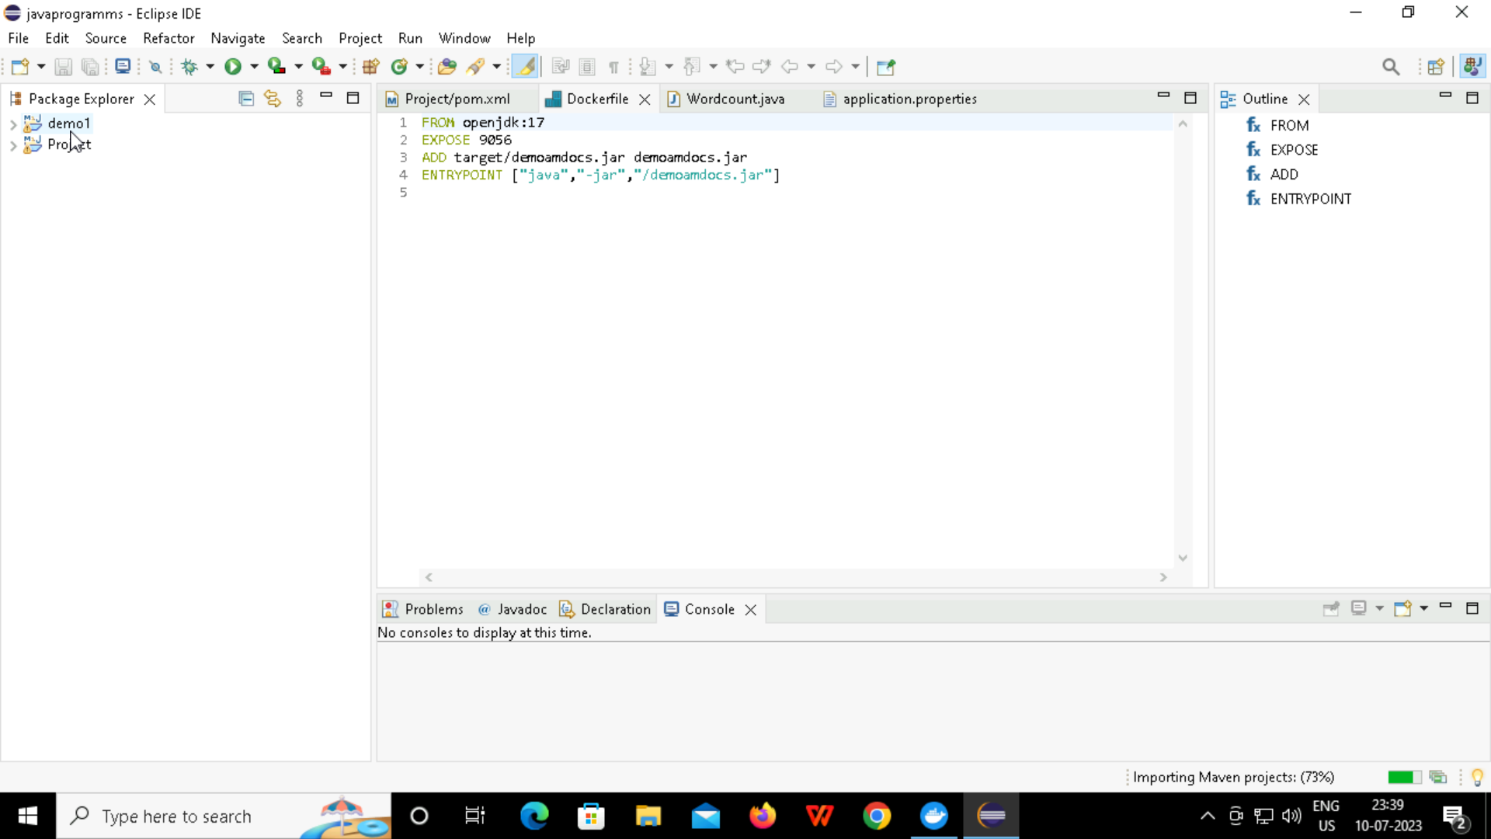
GOTO PROJECT

Slide 17
Creating simple spring boot project
GO TO THE FILE
CREATE ANY JAVA FILE
IN THE SRC/MAIN/JAVA
IN COM.DEMO FOLDER
CREATE A CLASS FILE
WRITE THE CODE
THEN GOTO RESOURCES>>APPLICATION
GIVE THE PORT NUMBER
THEN AFTER SAVING RUN THE PROGRAMM
RUN AS JAVA APPLICATION
GIVE THE LOCALPORT
AND RUN IT IN BROWSER

Slide 18
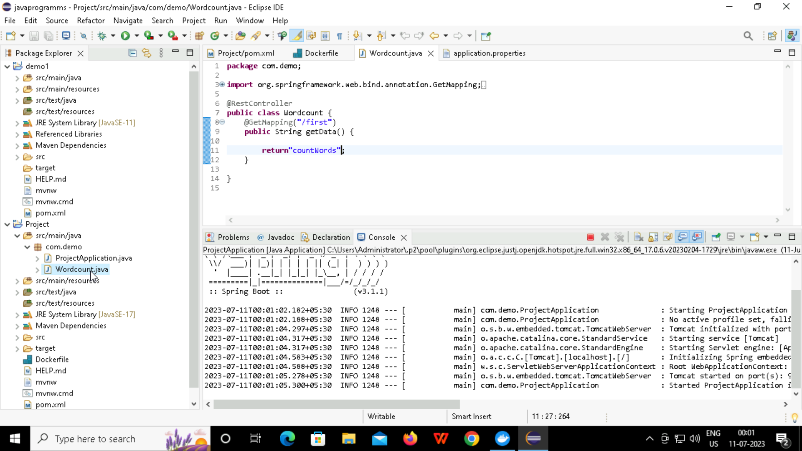
WORDCOUNT.JAVA

Slide 19
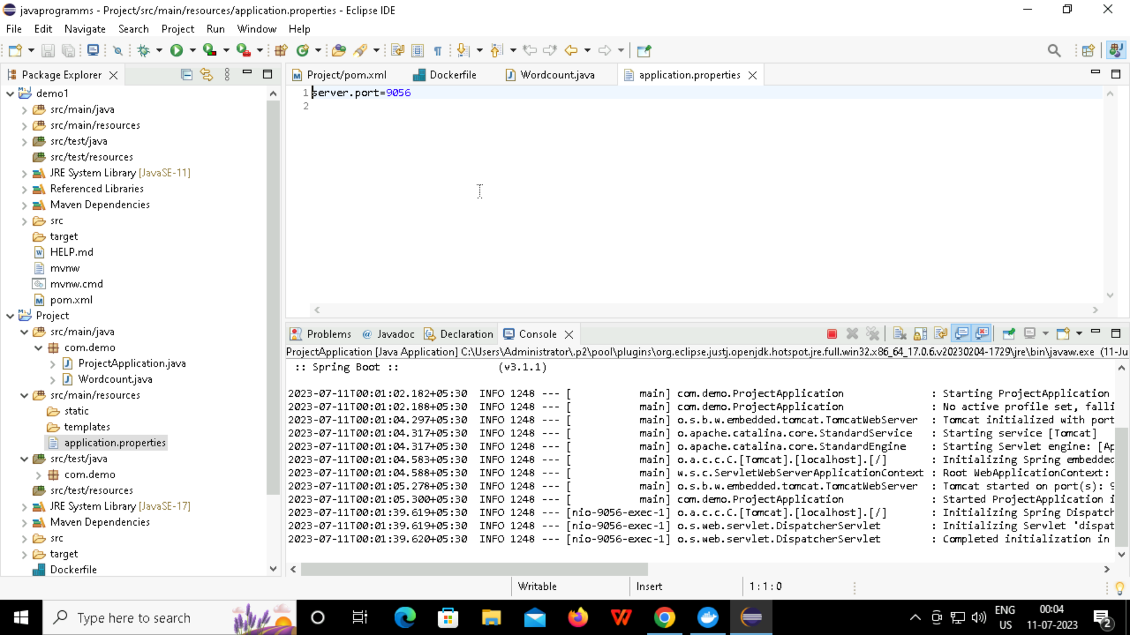
APPLICATION PORT

Slide 20
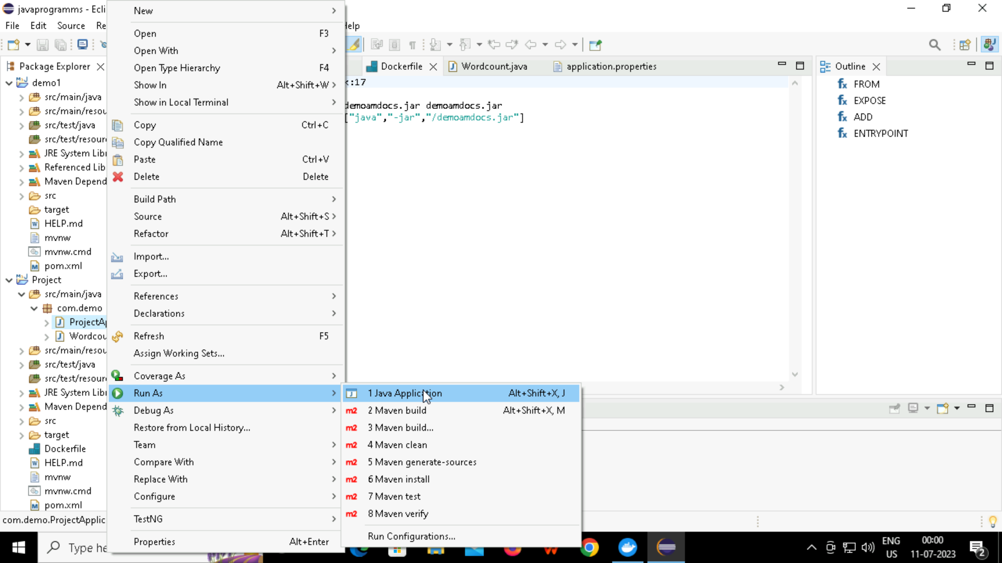
RUNNING JAVA APPLICATION

Slide 21
TOMACAT INTIALIZATION

Slide 22
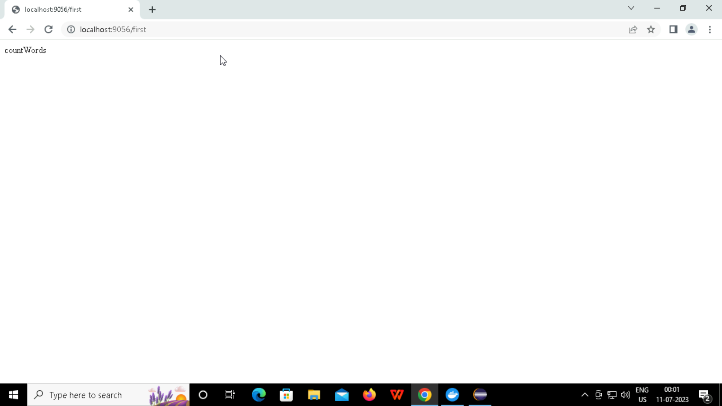
LOCALPORT:9056

Slide 23
SELENIUM:
What is selenium?
Selenium is a free (open-source) automated testing framework used to validate web applications across different browsers and platforms. You can use multiple programming languages like Java, C#, Python, etc to create Selenium Test Scripts. Testing done using the Selenium testing tool is usually referred to as Selenium Testing.

Slide 24
WHY WE USE SELENIUM?
Selenium WebDriver is a web framework that permits you to execute cross-browser tests. This tool is used for automating web-based application testing to verify that it performs expectedly. Selenium WebDriver allows you to choose a programming language to create test scripts

Slide 25
WHEN WE USE SELENIUM?
Selenium automates web browsers. It is most famous for enabling rapid, repeatable web-app testing, which allows developers to ship new releases faster and with confidence.

Slide 26
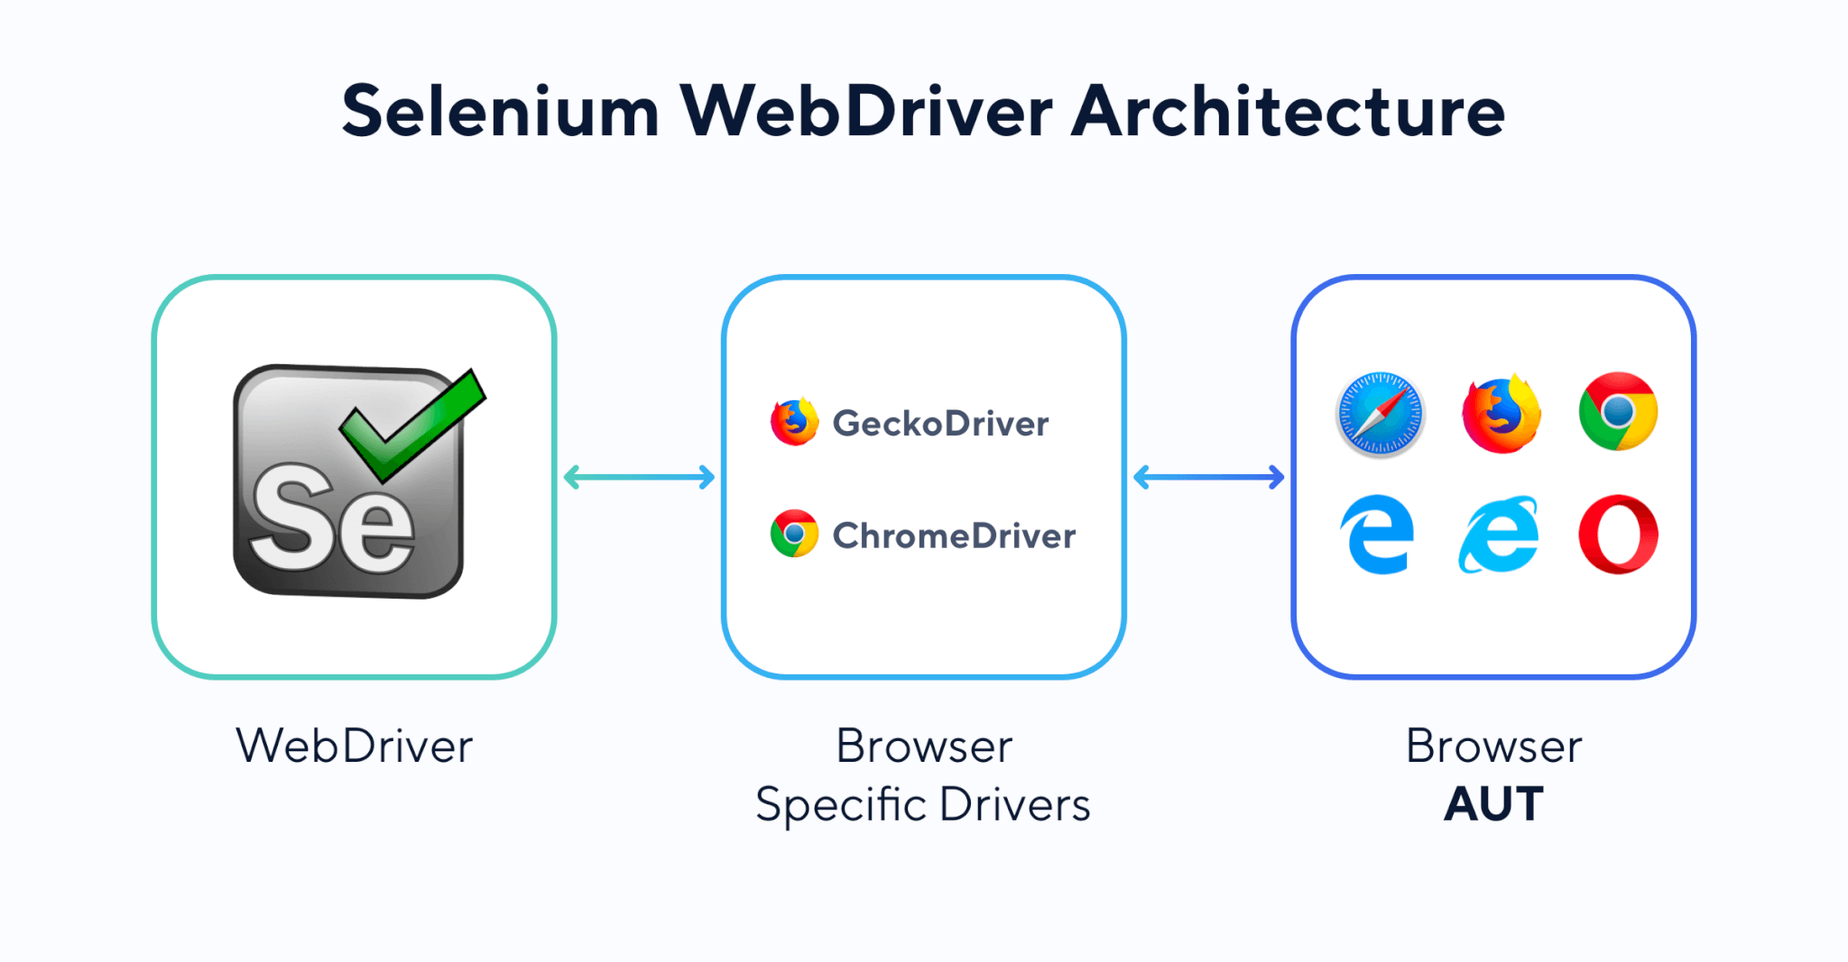
SELENUIM WEB DRIVER

Slide 27
HOW TO WORK WITH SELENIUM
FIRST OF ALL WE HAVE TO ADD DEPENDENCY FROM MAVEN REPOSITRY
ADD THE LATEST VERSION
COPY DEPENDENCY
ADD DEPENDENCY TO POM.XML
CREATE AND WRITE THE CODE
RUN AS JAVA APPLICATION

Slide 28
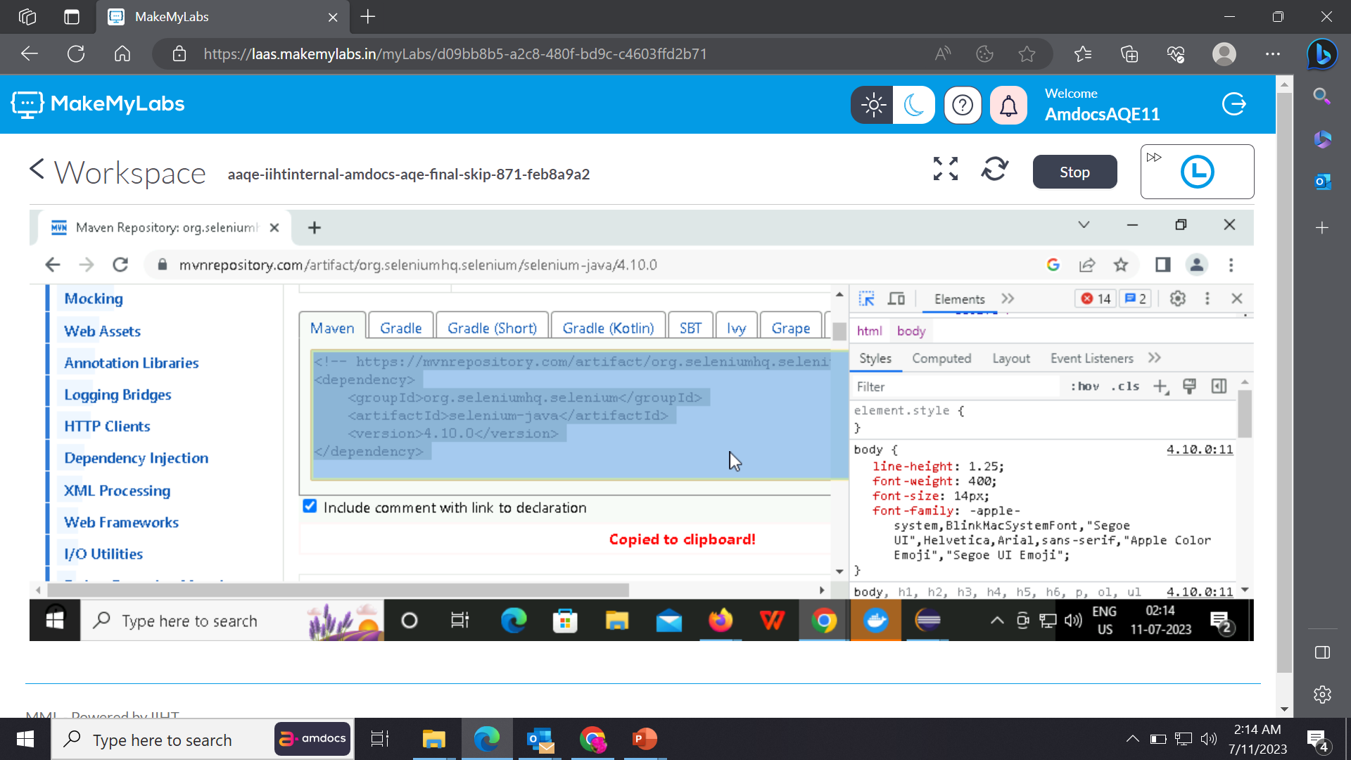
ADDING DEPENDENCY

Slide 29
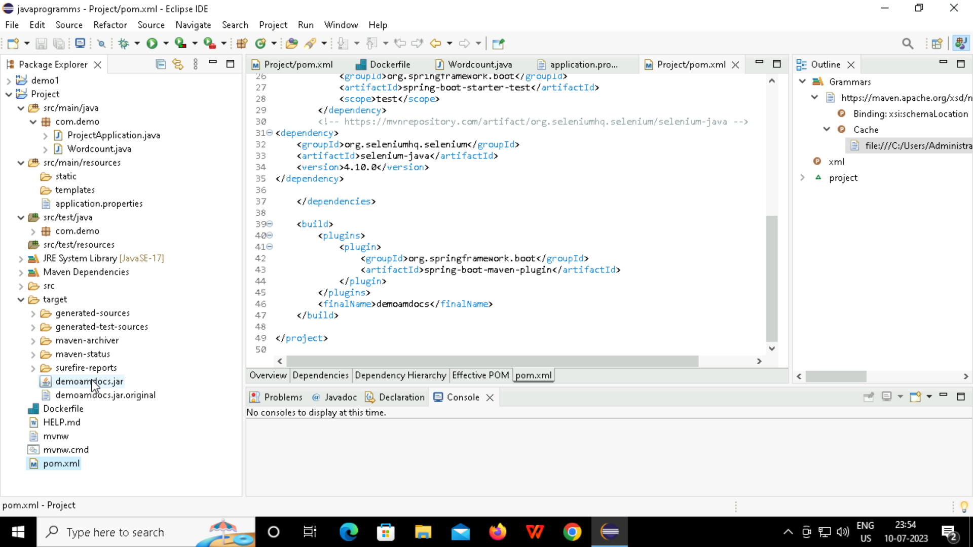
POM.XML

Slide 30
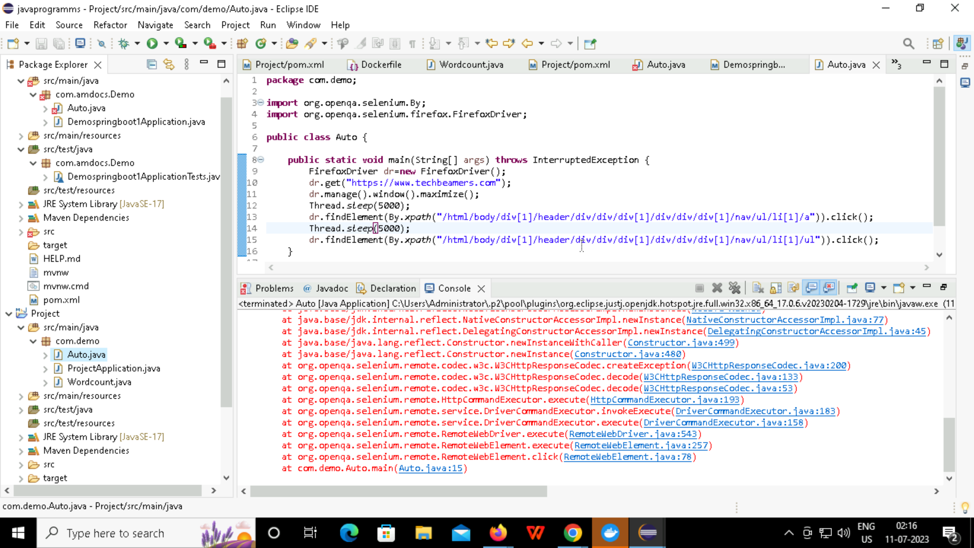
CREATING AUTO.JAVA FILE

Slide 31
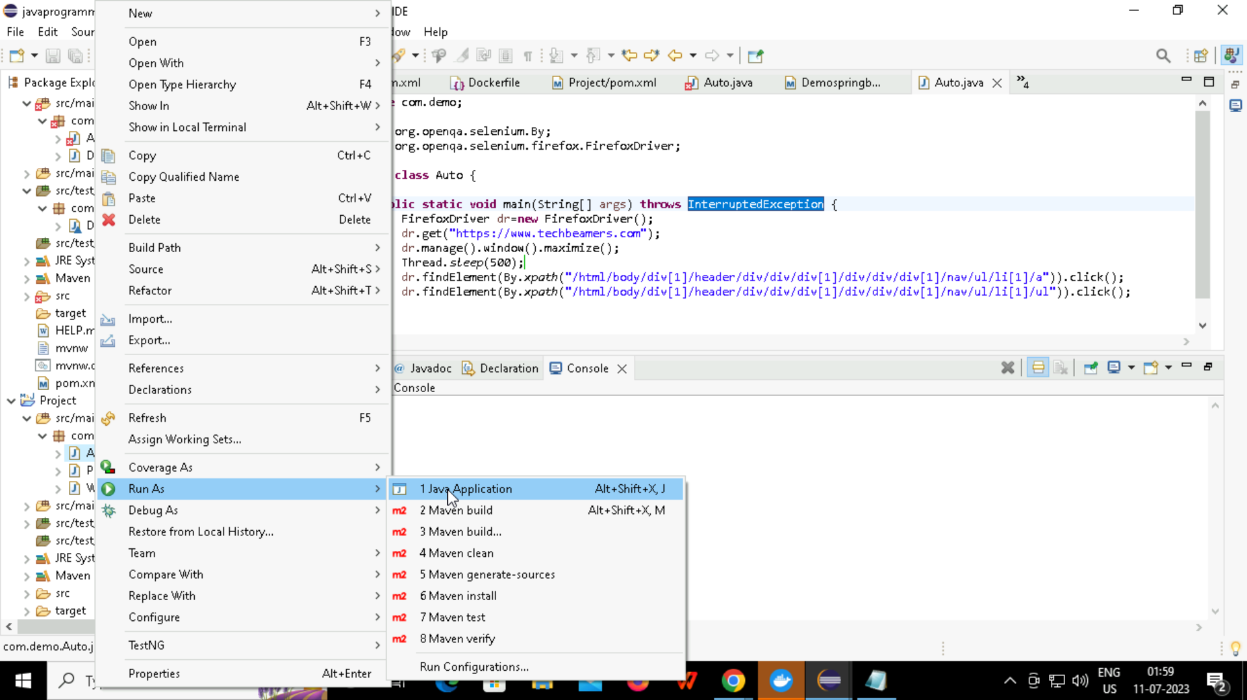
RUNNING THE FILE

Slide 32
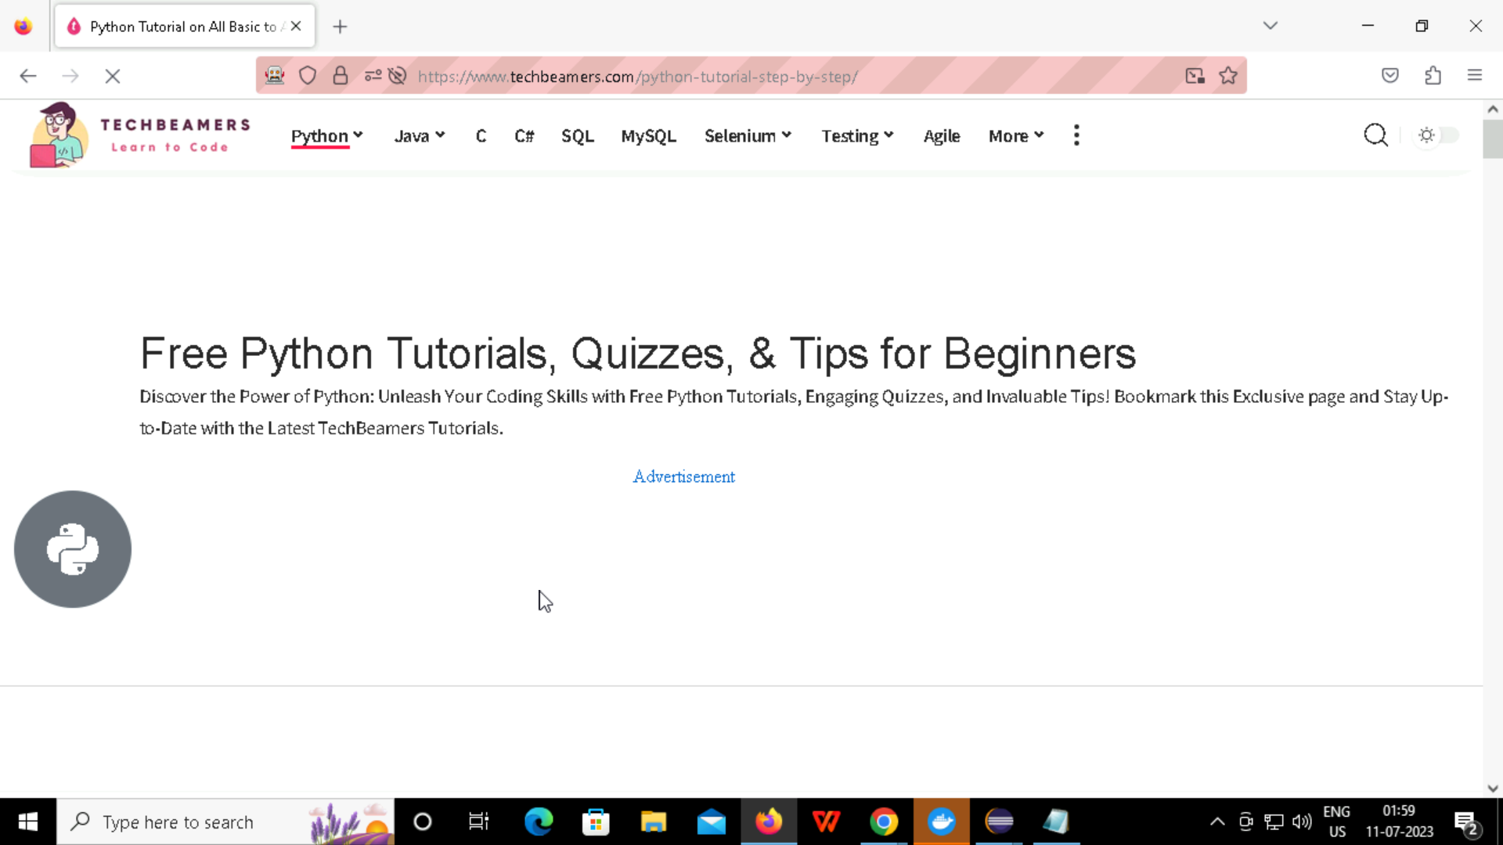
Getting on web

Slide 33
git
WHAT IS GIT?
Git is a an open source distributed version control system that is available for free under the GNU General Public License version
WHY WE USE GIT?
It is a free and open-source version control system used to handle small to very large projects efficiently. Git is used to tracking changes in the source code, enabling multiple developers to work together on non-linear development.

Slide 34
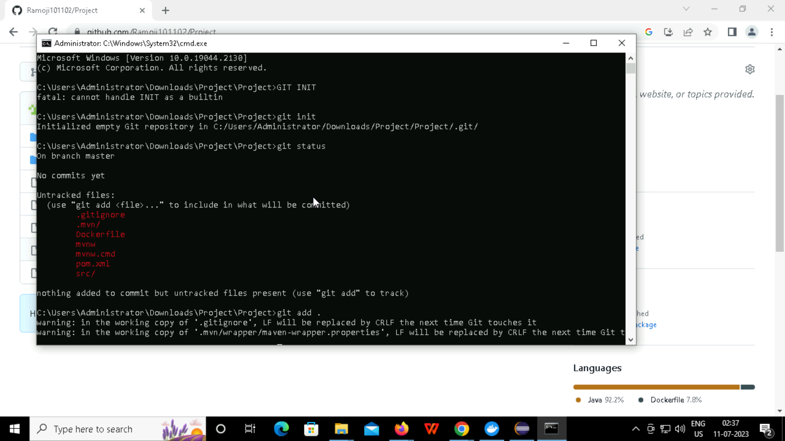
GIT INTIATION

Slide 35
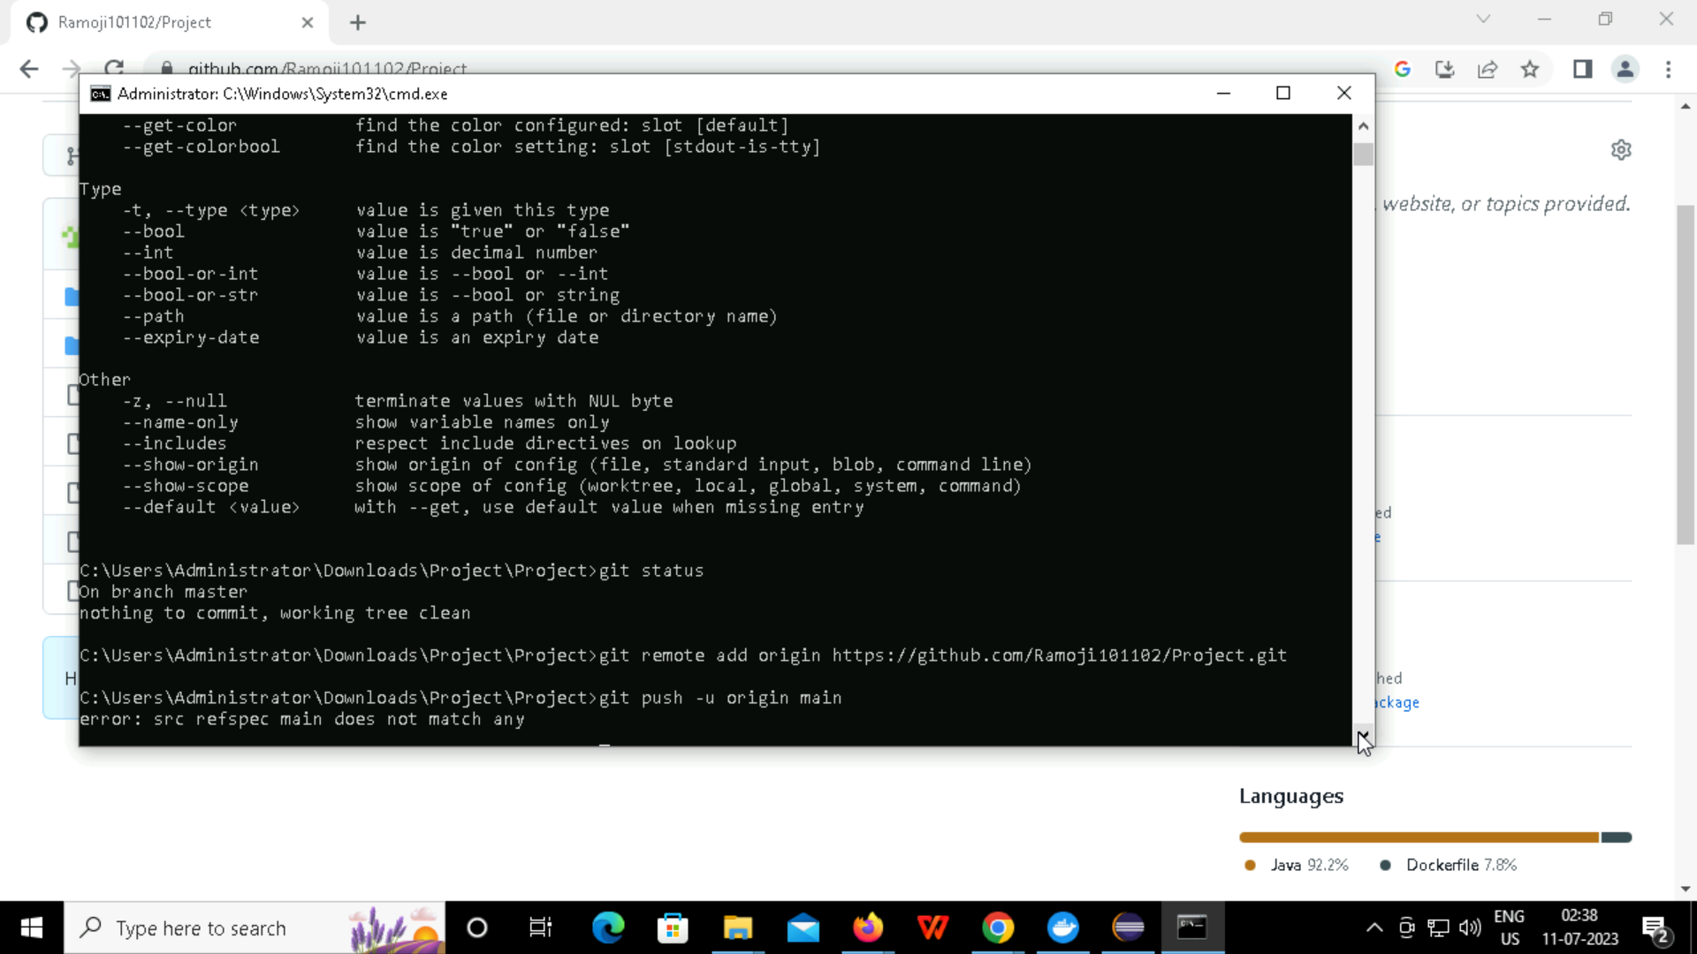
GIT COMMITING AND PUSHING

Slide 36
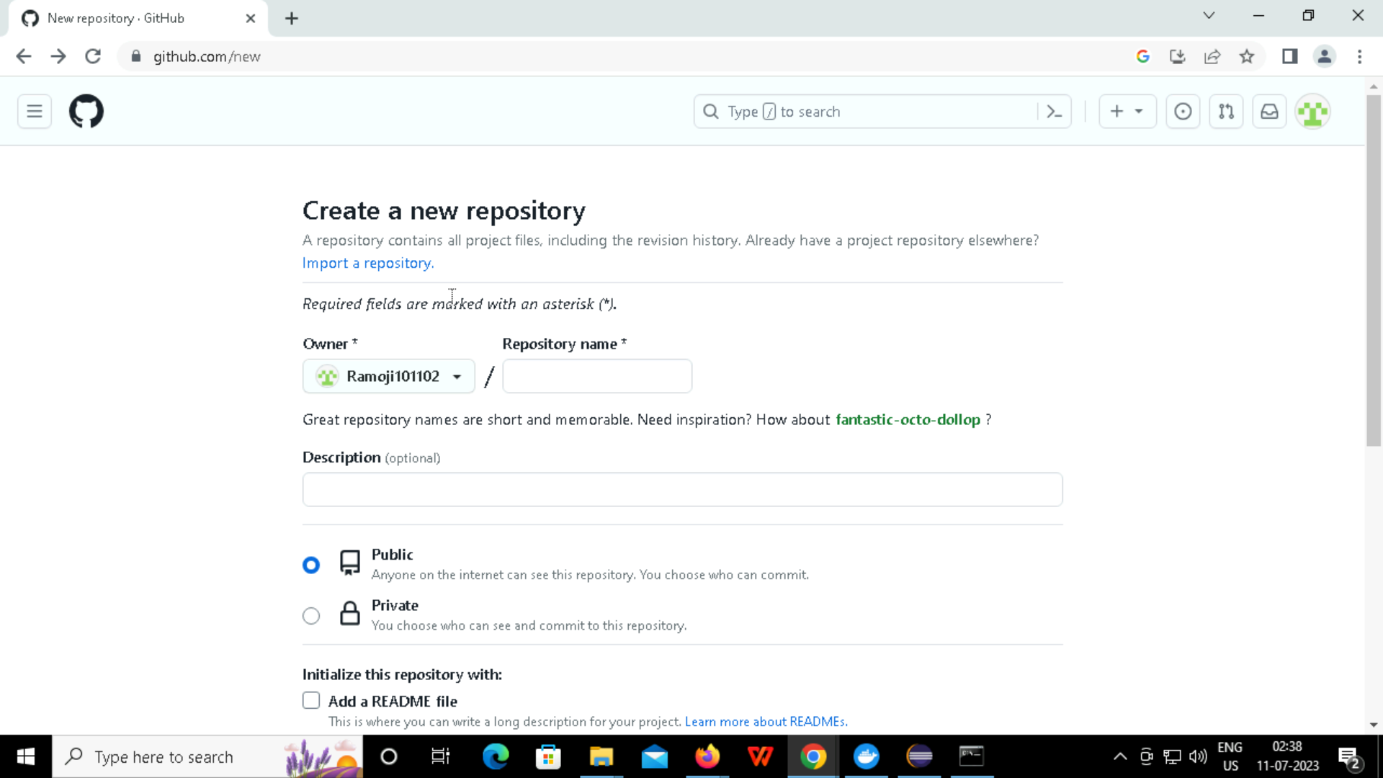
CREATE A GIT REPOSITRY

Slide 37
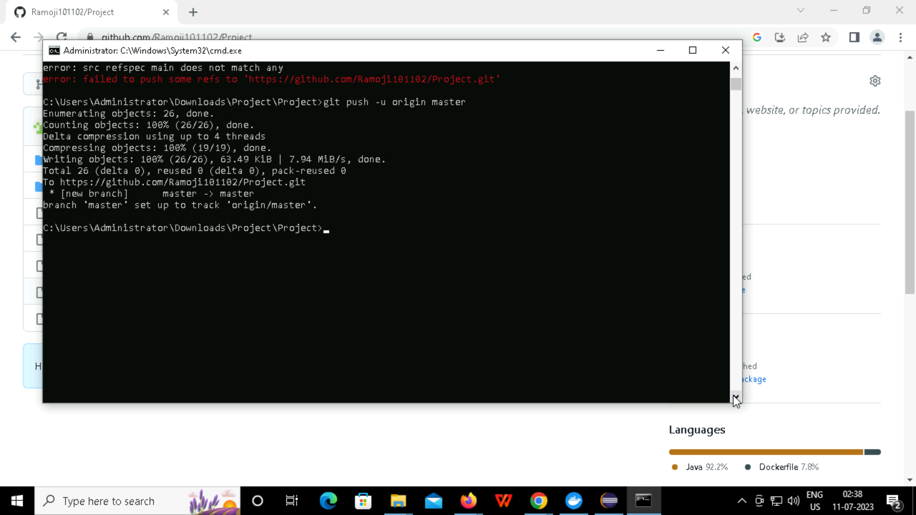
PUSHING TO MASTER

Slide 38
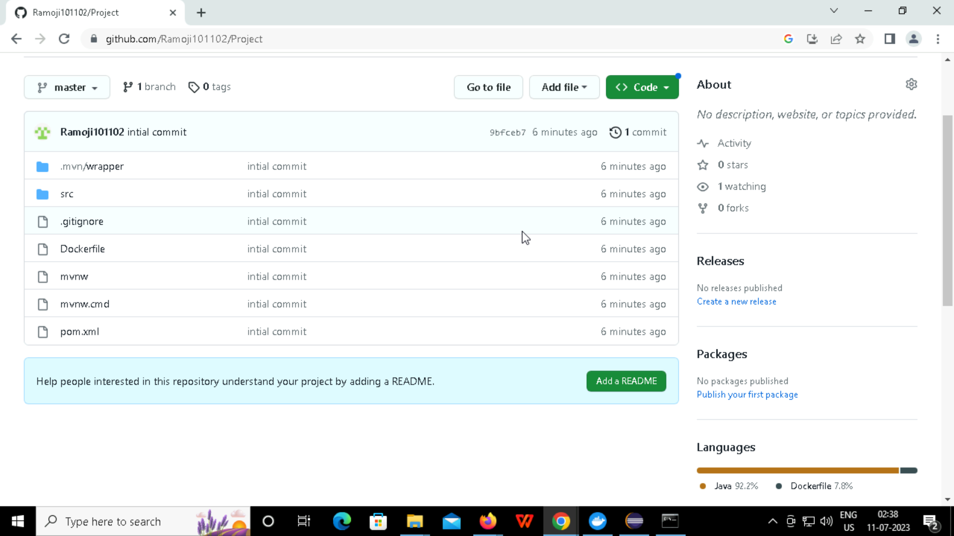
AFTER THAT CHECK BY REFRESHING IT

Slide 39
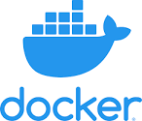
DOCKER
...
WHAT IS DOCKER?
Docker is an open source platform that enables developers to build, deploy, run, update and manage containers
WHY WE USE DOCKER?
Docker streamlines the development lifecycle by allowing developers to work in standardized environments using local containers which provide your applications and services.

Slide 40
WHAT IS CI/CD?
CONTINOUS INTEGRATION
CONTINOUS DEPLOYMENT
Continuous integration refers to the build and unit testing stages of the software release process. Every revision that is committed triggers an automated build and test. With continuous delivery, code changes are automatically built, tested, and prepared for a release to production.
Continuous deployment is a strategy in software development where code changes to an application are released automatically into the production environment. This automation is driven by a series of predefined tests. Once new updates pass those tests, the system pushes the updates directly to the software's users.

Slide 41
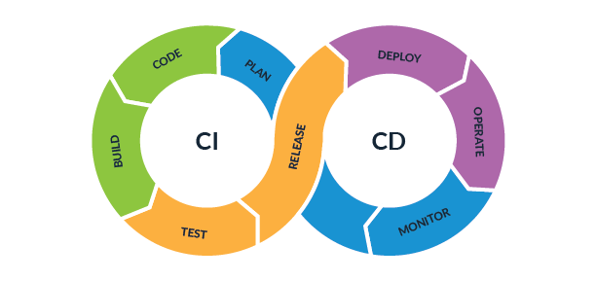
WHAT IS CI/CD PIPELINE?

Slide 42
Practical exercise 01
How to do work with docker generating image:
1.GOTO PROJECT THEN GIVE A RIGHT CLICK
2.CREATE A NEW FILE NAMED Docker file
3.THEN ENTER THE REQUIRED INTO THE PROJECT
4.PROCESS THE CODE
5.GOTO POM.XML
6.GENERATE A JAR FILE
7.BETWEEN BUILD AND PLUGIN 8.WRITE IN <FINALNAME>
9.CHECK FILES IN TARGET
10.AFTER RUN IT AS MAVEN INSTALL
*

Slide 43
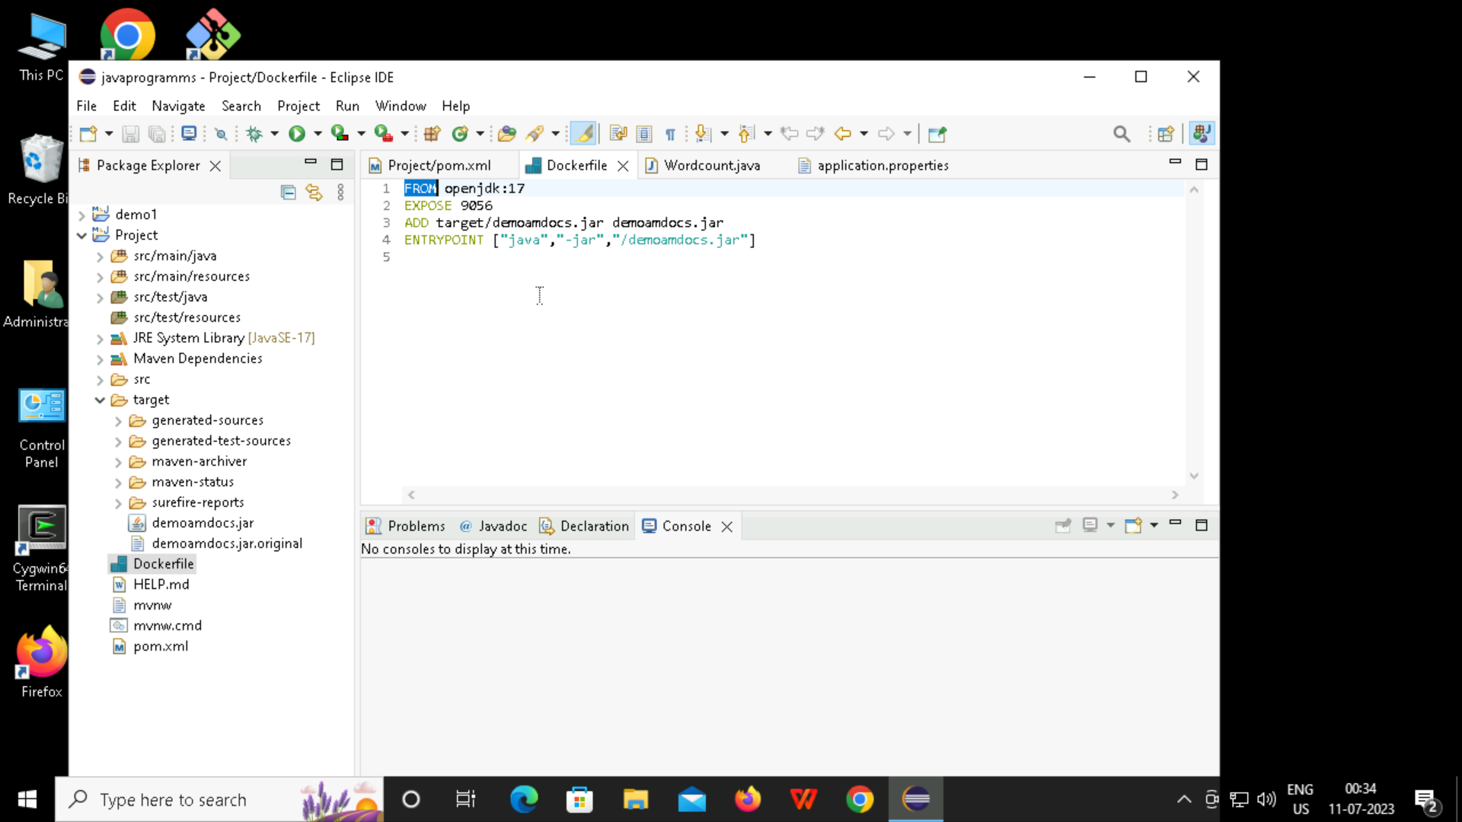
CREATING DOCKER FILE

Slide 44
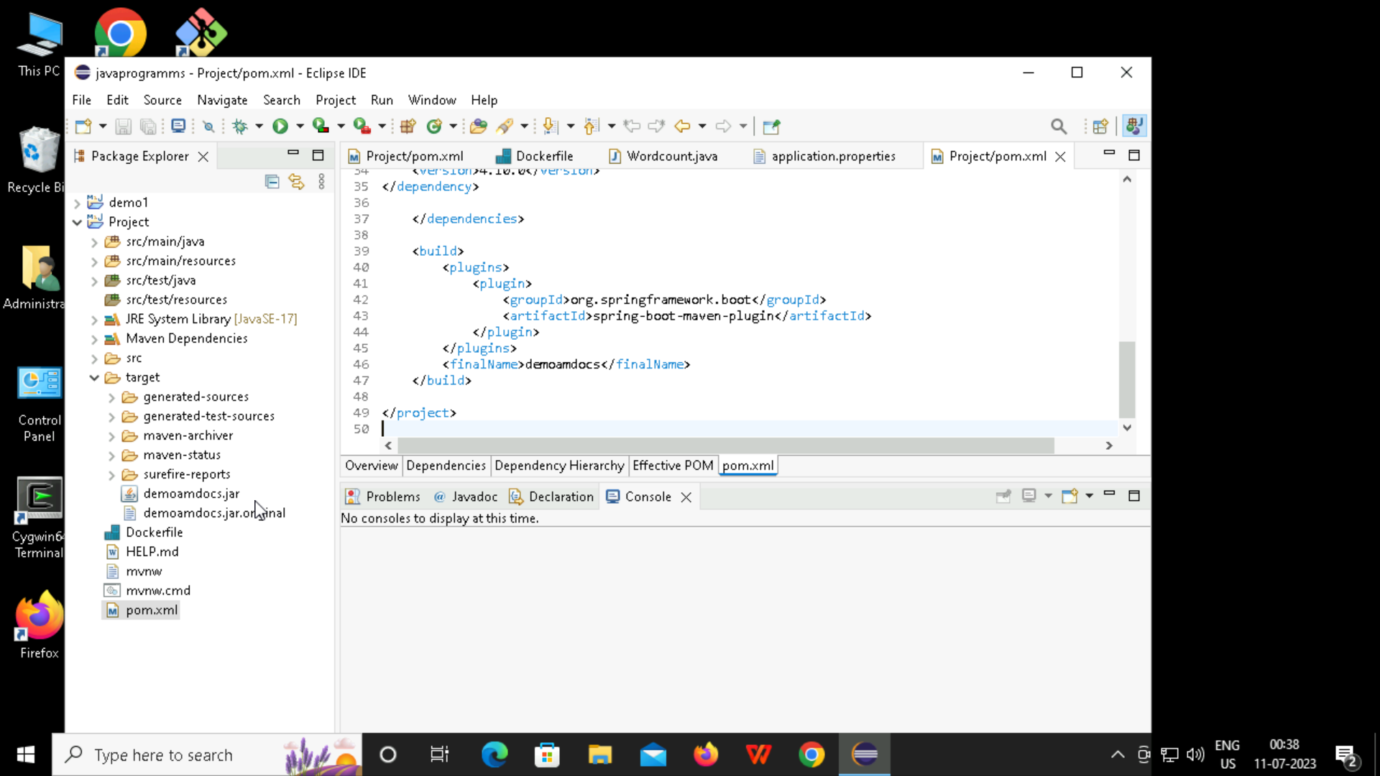
GENERATING JAR FILES

Slide 45
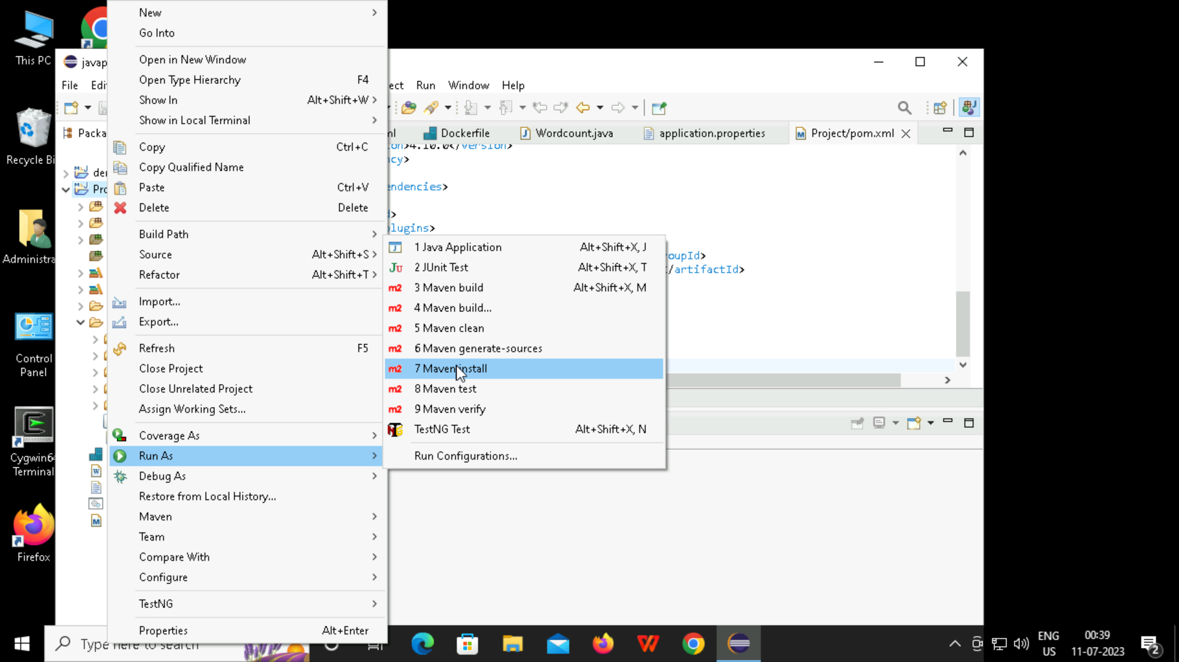
RUN USING MAVEN INSTALL

Slide 46
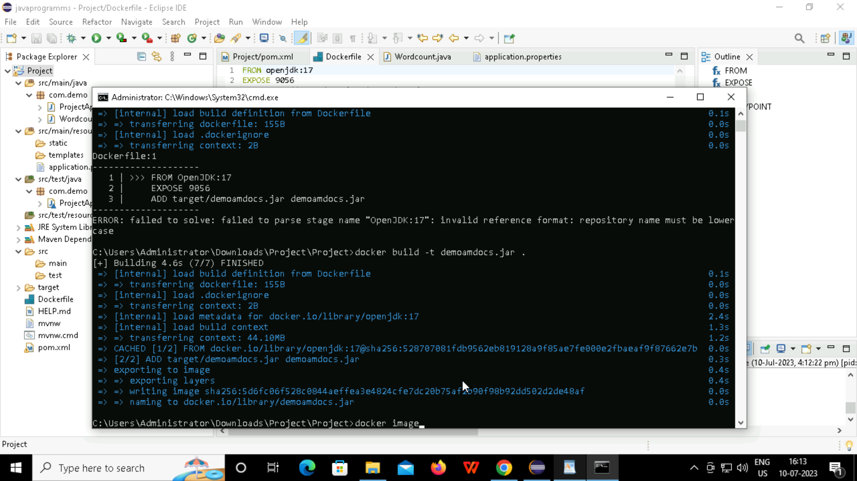
CREATE DOCKER IAMGE

Slide 47
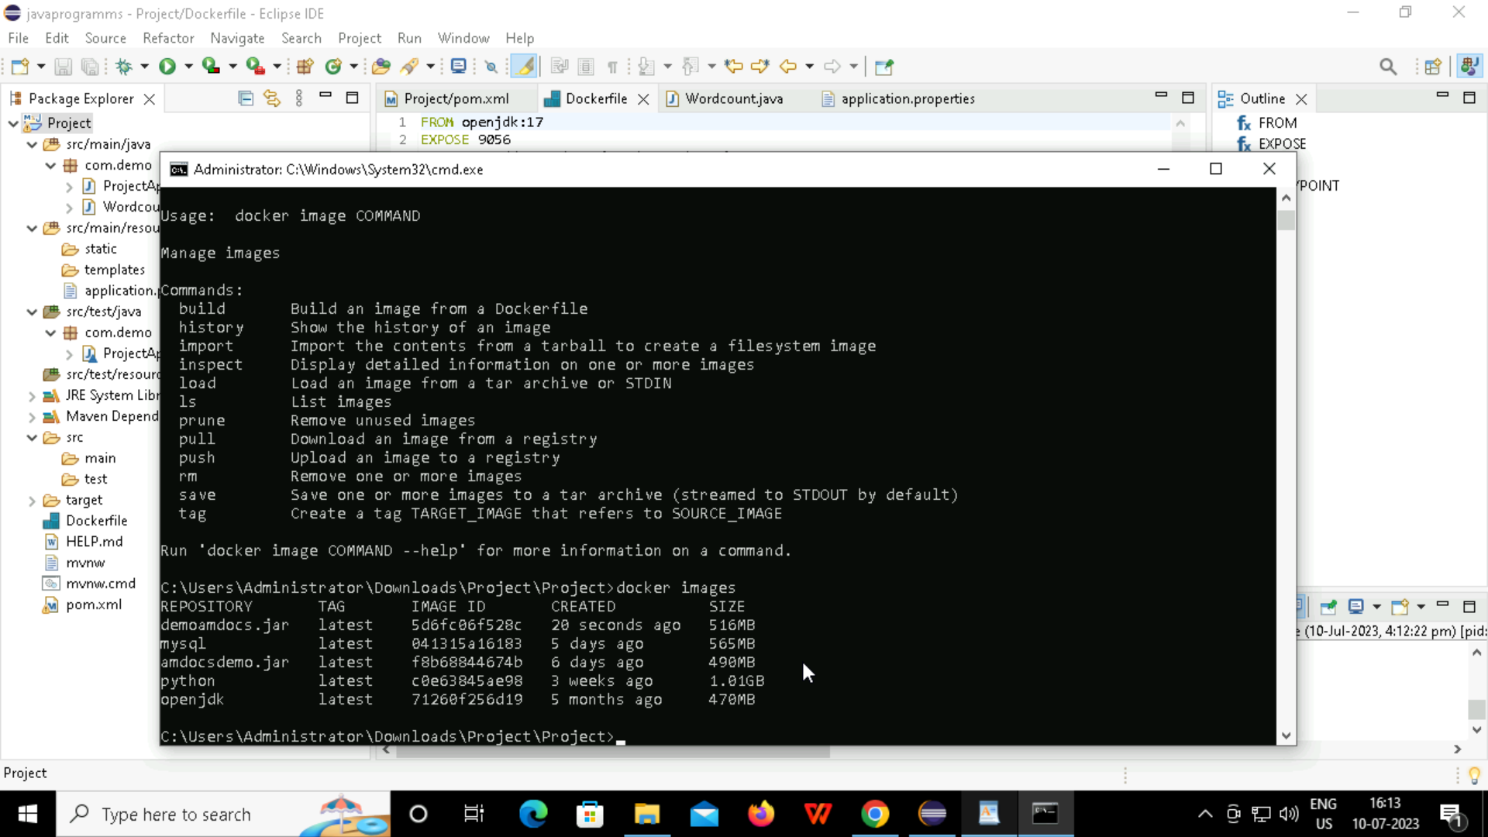
GETTING THE IMAGES FILES

Slide 48
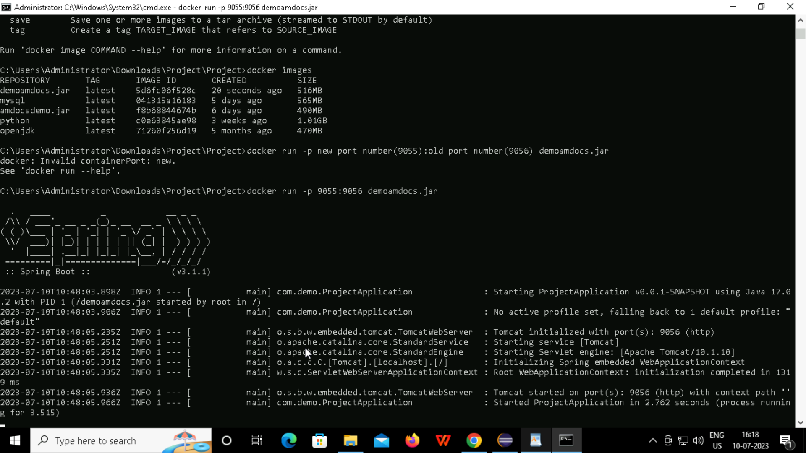
GENERATING NEW PORT(RUN)

Slide 49
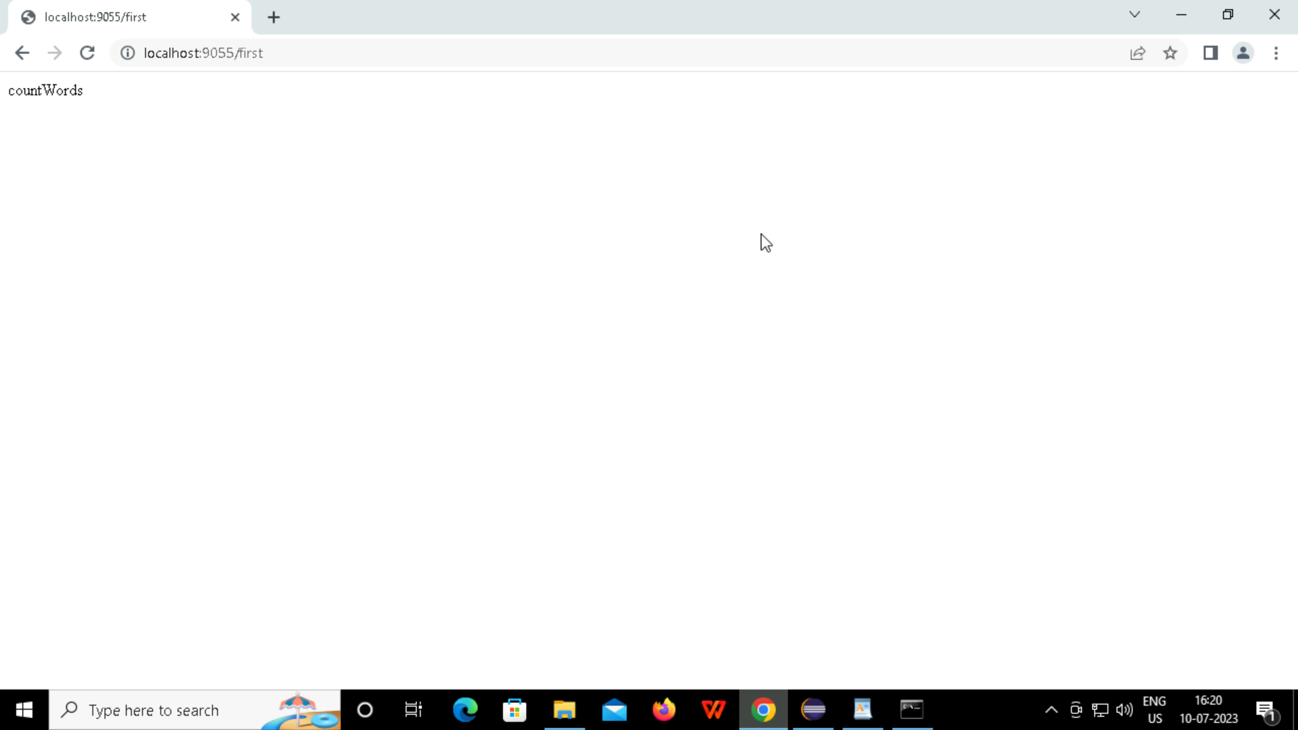
RUNNING AT NEW PORT ADRESS

Slide 50
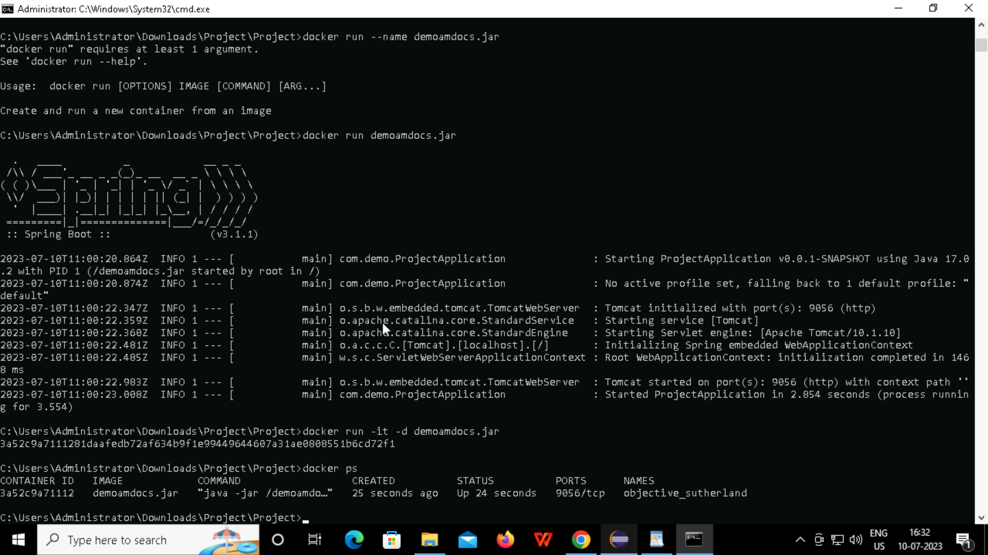
PUSHING INTO DOCKER HUB

Slide 51
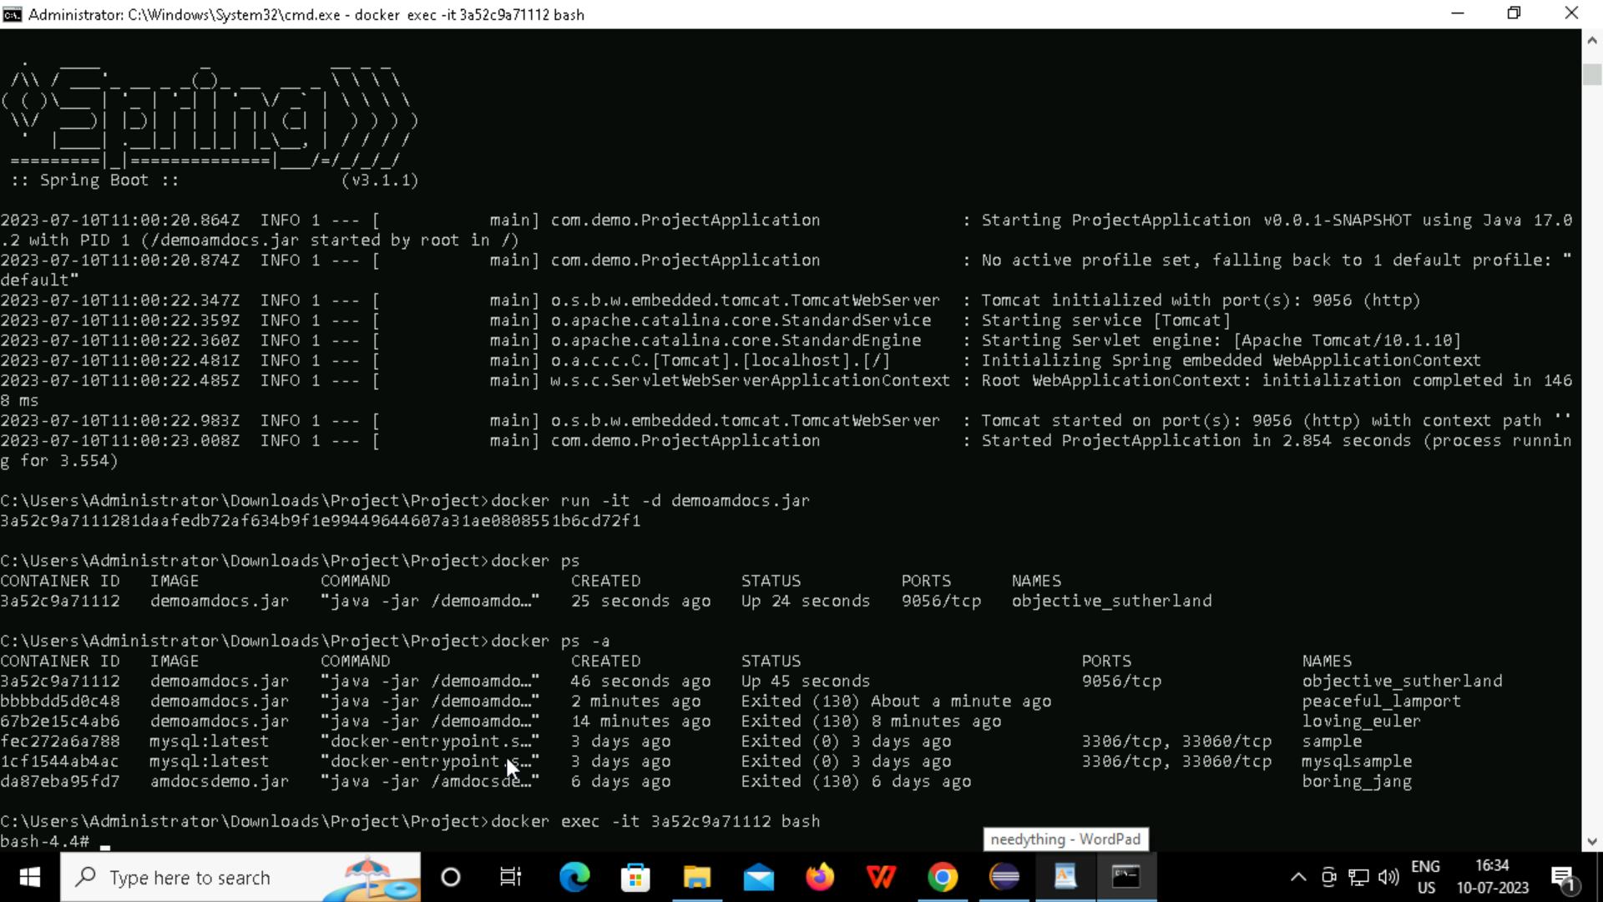

Slide 52
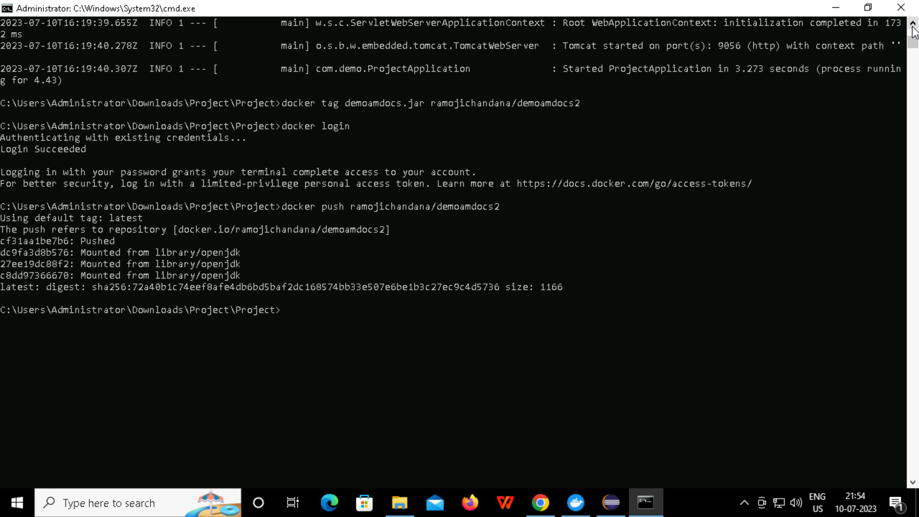

Slide 53

A picture is worth a thousand words
THANK YOU

